Slide 1
4.5: The Law of Cosines
MATH 1550 - Precalculus

Slide 2
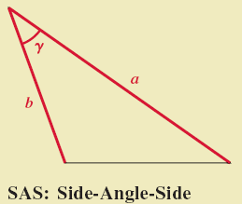
Case for Law of Cosines
Case 3:

Slide 3
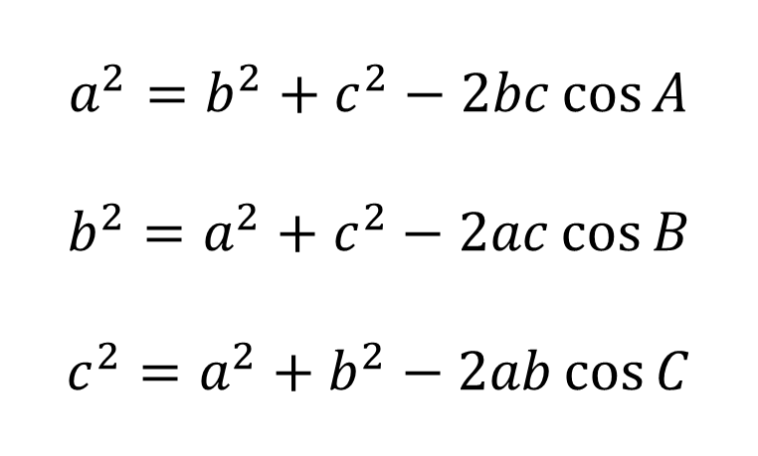
(Law of Cosines) For any triangle,
C
$$a^{2}=b^{2}+c^{2}−2bc\cos{A}$$
$$b^{2}=a^{2}+c^{2}−2ac\cos{B}$$
$$c^{2}=a^{2}+b^{2}−2ab\cos{C}$$
a
b
A
B
c

Slide 4
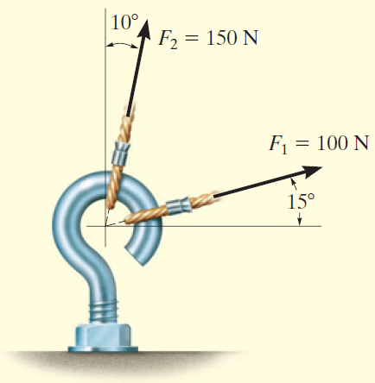
Ex) The forces F₁, F₂ act on the screw eye below. Find the magnitude of the resultant force.
150 N
115⁰
100 N

